Slide 1

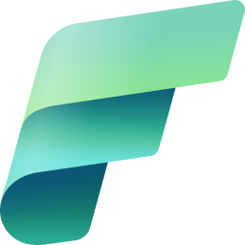
Microsoft Fabric
A unified analytics solution for the era of AI
Mahmoud Abd El-Raheem

Slide 2
Agenda
1
Microsoft Fabric - unified solution
7
One Lake Data Hub
2
Microsoft Fabric - for the era of AI
8
Fabric Terminology
3
Fabric Home & Experience
9
Fabric Capacity
4
One Lake
10
MS Fabric as a Complete Data Platform
5
One Copy For all computes
11
Direct Lake
One Lake Scenarios
12
Microsoft Fabric: Complete Data Platform Without Denodo
6
2

Slide 3

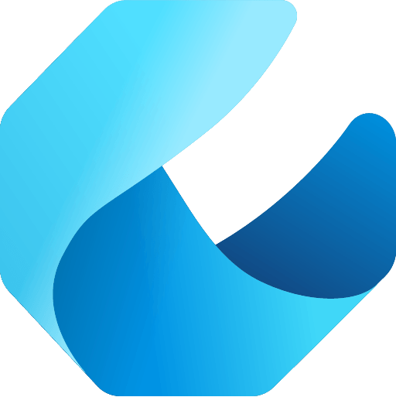

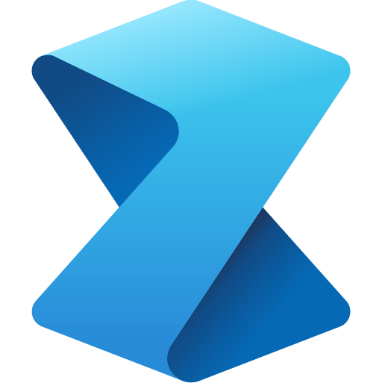

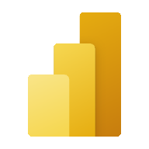
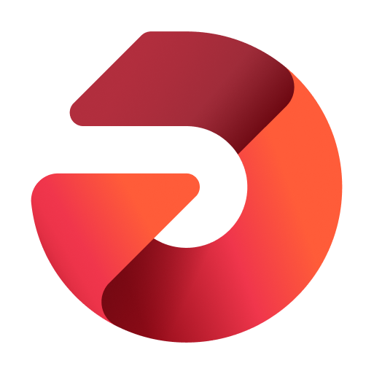

Microsoft Fabric - unified solution
Microsoft Fabric is an all-in-one analytics solution for enterprises that covers everything from data movement to data science, Real-Time Analytics, and business intelligence. It offers a comprehensive suite of services, including data lake, data engineering, and data integration, all in one place
Data Integration
Data Engineering
Data Warehouse
Data Science
Real Time Analytics
Business Intelligence
Observability
Data Factory
Synapse
Synapse
Synapse
Synapse
Power BI
Data Activator
Unified data foundation
OneLake
UNIFIED
SaaS product experience
Security and governance
Compute and storage
Business model
Notes:
Data Factory : This combines the Azure data factory and Power Query enabling the construction of dataflows and data pipelines .
Synapse Data Engineering :This provides a Spark platform with great authoring experiences. This enables data engineers to perform large scale data transformation and democratize data through the lakehouse.
Synapse Data Science : This enables you to build, deploy, and operationalize machine learning models. It integrates with Azure Machine Learning to provide built-in experiment tracking and model registry.
Synapse Real Time Analytics : Through ingestion through event streams or processing in KQL Through ingestion through event streams or processing in KQL (Kusto Query Language). Fabric is designed to work with real time data.
Power BI : Fabric contains a cloud version of this Business intelligence Platform.
Data Activator : This monitors data in Power BI reports and Event streams items. When data hits certain thresholds or matches other patterns, it automatically takes appropriate action such as sending out alerts
One Lake :The Data Warehouse experience provides industry leading SQL performance and scale. It separates compute from storage, enabling independent scaling of both the components. It stores data in the open Delta Lake format.
_________________________
Microsoft Fabric combines Data Factory, Synapse Analytics, Data Explorer, and Power BI into a single, unified experience, on the cloud. The open and governed data lakehouse foundation is a cost-effective and performance-optimized fabric for business intelligence, machine kerning, and AI workloads at any scale. It is the foundation for migrating and modernizing existing analytics solutions, whether this be data appliances or traditional data warehouses.
Talk Track for Greenfield/Growing Analytics Customers – Microsoft Fabric’s SaaS environment makes it easier to deploy an entire end-to-end analytics engine from the ground up at an accelerated pace. With the solution’s built-in security and governance capabilities, you can be rest assured your data and insights are protected.
Talk Track for Existing Synapse Customers – Microsoft Fabric is an evolution of Azure Synapse. You will still be able to enjoy the benefits and limitless scale of Synapse in an easier to use SaaS solution while adopting new capabilities that enhance your entire analytics approach. And with the addition of Power BI, you can help democratize the ability to uncover insights and create interactive reports across the organization, helping everyone make more data-driven decisions in their everyday work.
Talk Track for Existing Power BI Customers – With Microsoft Fabric, you’ll be able to access new and powerful data tools and services like Azure Synapse within the same user experience you already enjoy with Power BI. You can unify these tools with your disparate data sources in the same environment to establish a single source of truth for all data, driving the ability for everyone to uncover more accurate and consistent insights than before. And instead of having to worry about security concerns of a patchwork analytics estate, you can be rest assured your data is protected with the built-in security and governance capabilities.

Slide 4


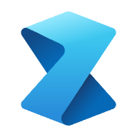



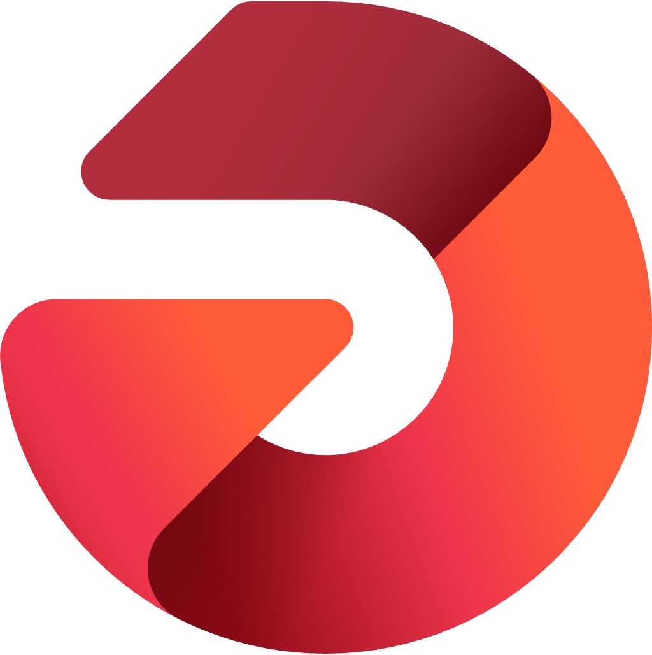
The data platform for the era of AI
Microsoft Fabric
Single…
Onboarding and trials
Sign-on
Navigation model
UX model
Workspace organization
Collaboration experience
Data Lake
Storage format
Data copy for all engines
Security model
CI/CD
Monitoring hub
Data Hub
Governance & compliance
Data
Factory
Synapse Data
Engineering
Synapse Data
Science
Synapse Data Warehousing
Synapse Real
Time Analytics
Power BI
Data
Activator
AI Assisted
Shared Workspaces
Universal Compute Capacities
OneSecurity
OneLake
The Intelligent data foundation

Slide 5
Data Analytics for era of AI
Microsoft Fabric
Complete Analytics Platform
Lake Centric and Open
Empower Every Business User
Complete Analytics Platform
Everything, unified
One Lake
Familiar and intuitive
Copilot accelerated
SaaS
One copy
Built into Microsoft 365
Gen AI on your data
Secured and governed
Open at every tier
Insight to action
AI-driven insights
Notes:
Copilot accelerated
Gen AI on your data
AI-driven insights
Data Factory : This combines the Azure data factory and Power Query enabling the construction of dataflows and data pipelines .
Synapse Data Engineering :This provides a Spark platform with great authoring experiences. This enables data engineers to perform large scale data transformation and democratize data through the lakehouse.
Synapse Data Science : This enables you to build, deploy, and operationalize machine learning models. It integrates with Azure Machine Learning to provide built-in experiment tracking and model registry.
Synapse Real Time Analytics : Through ingestion through event streams or processing in KQL Through ingestion through event streams or processing in KQL (Kusto Query Language). Fabric is designed to work with real time data.
Power BI : Fabric contains a cloud version of this Business intelligence Platform.
Data Activator : This monitors data in Power BI reports and Event streams items. When data hits certain thresholds or matches other patterns, it automatically takes appropriate action such as sending out alerts
One Lake :The Data Warehouse experience provides industry leading SQL performance and scale. It separates compute from storage, enabling independent scaling of both the components. It stores data in the open Delta Lake format.
_________________________
Microsoft Fabric combines Data Factory, Synapse Analytics, Data Explorer, and Power BI into a single, unified experience, on the cloud. The open and governed data lakehouse foundation is a cost-effective and performance-optimized fabric for business intelligence, machine kerning, and AI workloads at any scale. It is the foundation for migrating and modernizing existing analytics solutions, whether this be data appliances or traditional data warehouses.
Talk Track for Greenfield/Growing Analytics Customers – Microsoft Fabric’s SaaS environment makes it easier to deploy an entire end-to-end analytics engine from the ground up at an accelerated pace. With the solution’s built-in security and governance capabilities, you can be rest assured your data and insights are protected.
Talk Track for Existing Synapse Customers – Microsoft Fabric is an evolution of Azure Synapse. You will still be able to enjoy the benefits and limitless scale of Synapse in an easier to use SaaS solution while adopting new capabilities that enhance your entire analytics approach. And with the addition of Power BI, you can help democratize the ability to uncover insights and create interactive reports across the organization, helping everyone make more data-driven decisions in their everyday work.
Talk Track for Existing Power BI Customers – With Microsoft Fabric, you’ll be able to access new and powerful data tools and services like Azure Synapse within the same user experience you already enjoy with Power BI. You can unify these tools with your disparate data sources in the same environment to establish a single source of truth for all data, driving the ability for everyone to uncover more accurate and consistent insights than before. And instead of having to worry about security concerns of a patchwork analytics estate, you can be rest assured your data is protected with the built-in security and governance capabilities.

Slide 6
SaaS
“it just works"
5 seconds to signup, 5 minutes to wow
Success by Default
Centralized administration
5x5
Frictionless onboarding
Minimal knobs
Tenant-wide governance
Instant Provisioning
Auto optimized
Centralized security management
Quick results w/ Intuitive UX
Auto Integrated
Compliance built-in

Slide 7
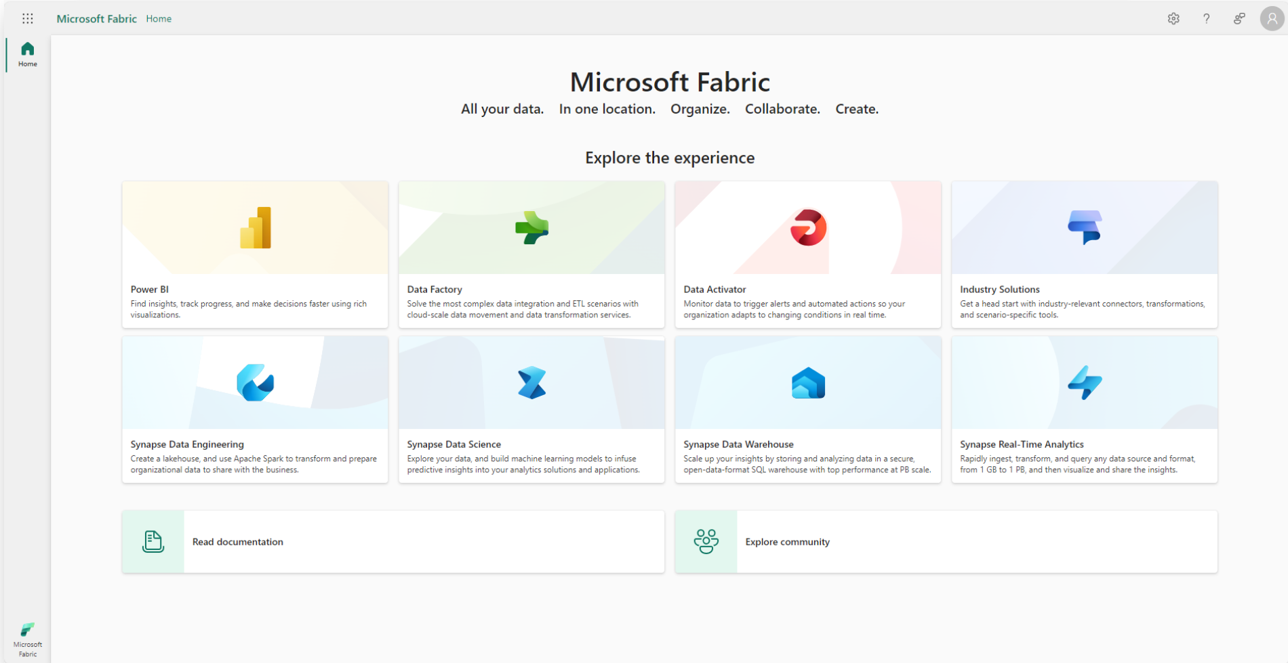
Fabric Home

Slide 8
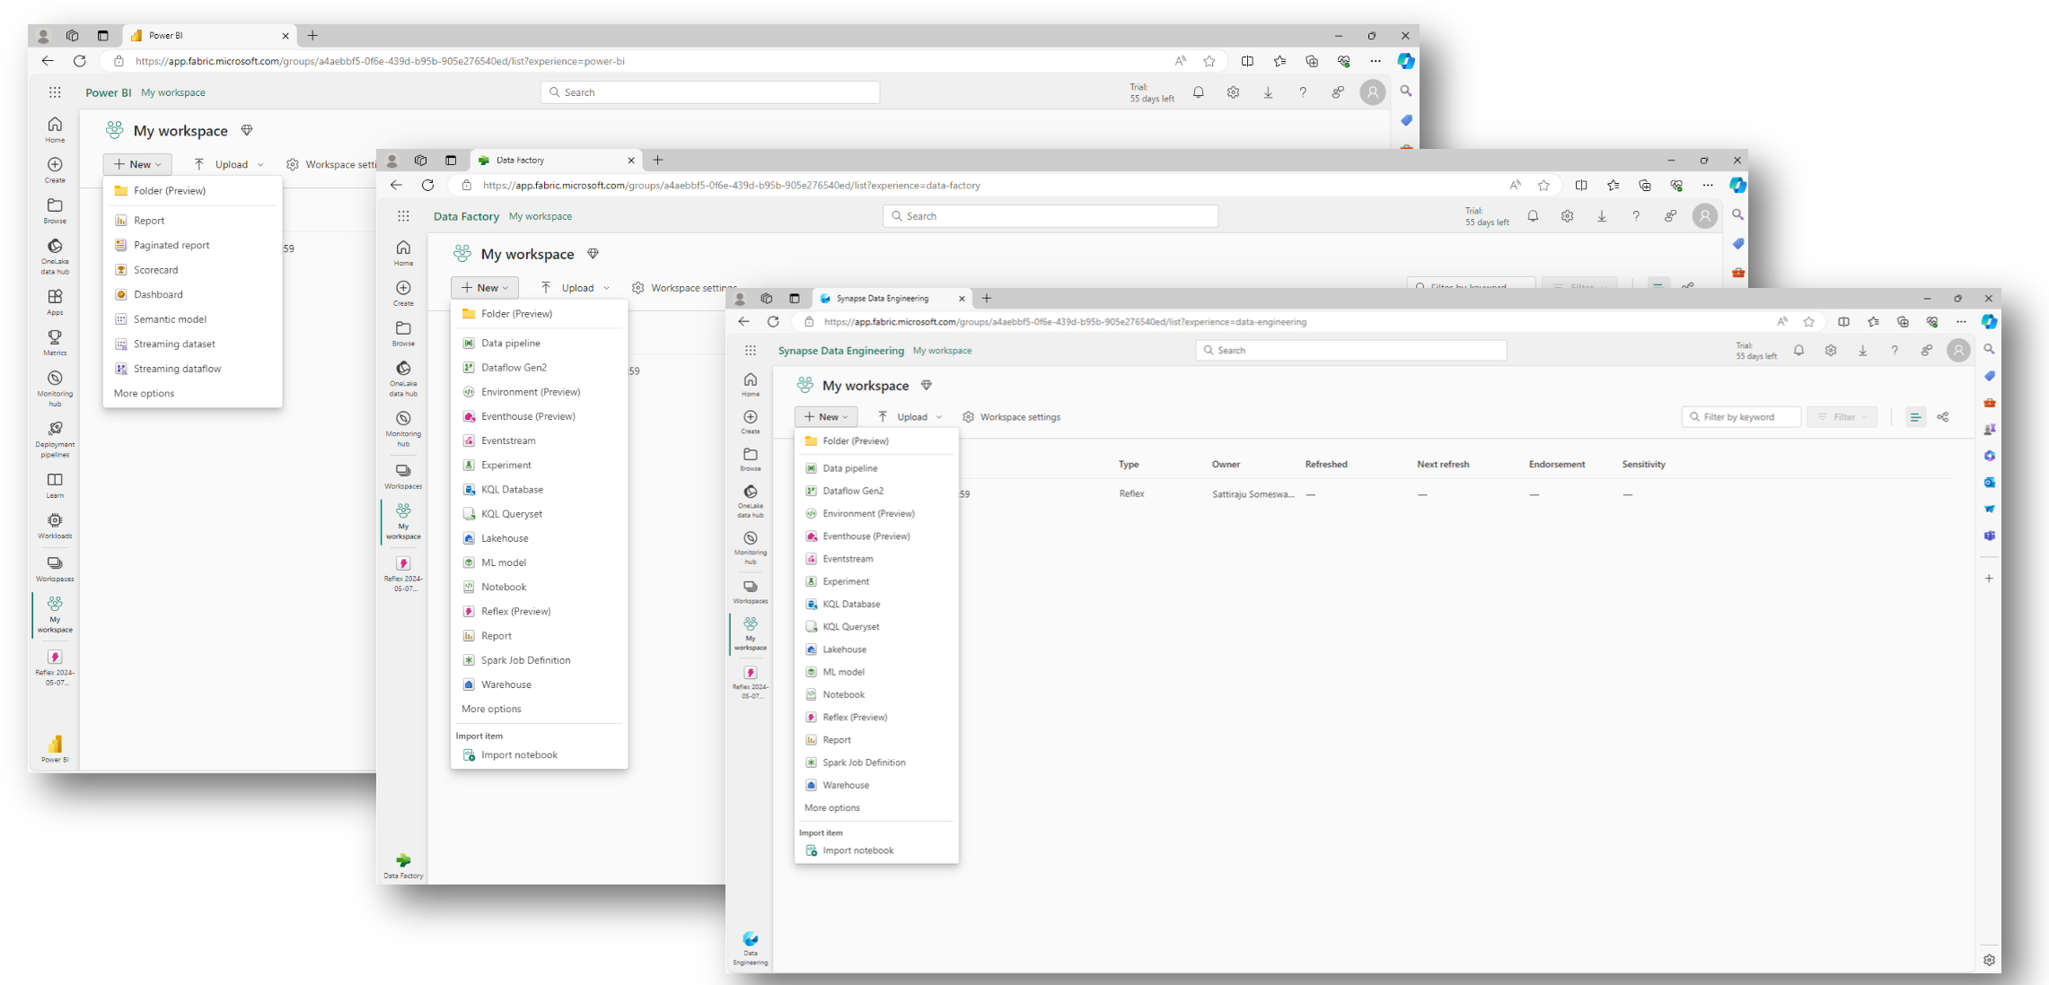
Experience

Slide 9
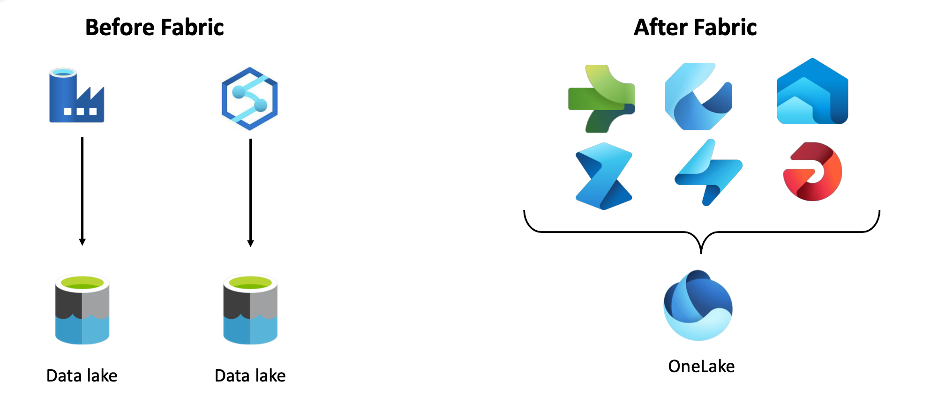
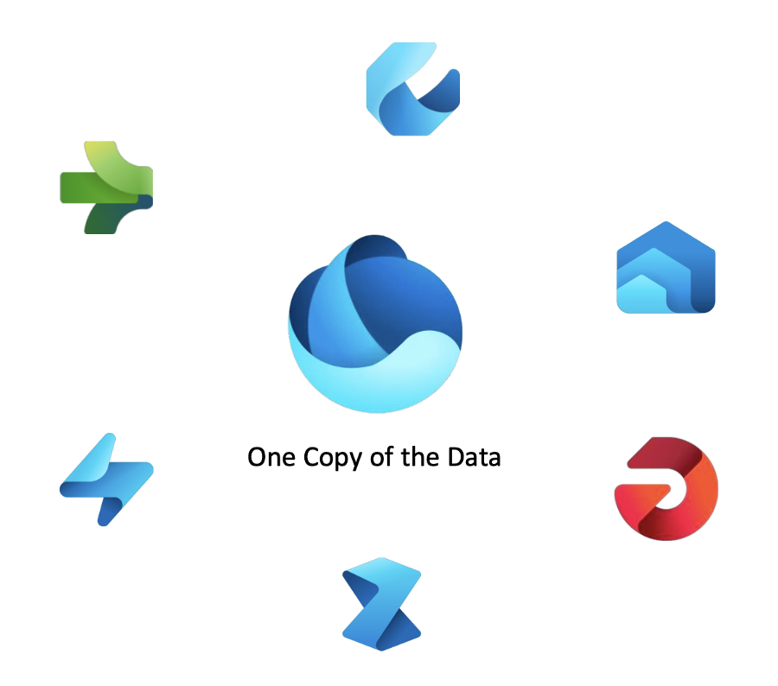
One Lake
Notes:
Before Fabric:
Different services (e.g., Azure Data Factory, Synapse Analytics) required separate data lakes, leading to data silos and duplication.
After Fabric:
One Lake acts as a unified data lake for all Fabric services, eliminating the need for multiple data lakes.
Different Fabric workloads (Data Engineering, Data Science, Real-time Analytics, Warehousing, BI) use One Copy of the Data, improving efficiency.
Microsoft Fabric centralizes data storage in One Lake, ensuring data consistency, accessibility, and reduced duplication across analytics and AI workloads.

Slide 10


One Lake For All Data
The OneDrive For Data
One Lake
A single unified logical SaaS data lake for the whole organization (no silos)
Organize data into domains
Foundation for all Fabric data items
Provides full and open access through industry standard APIs and formats to any application (no lock-in)
Data
Factory
Synapse Data Warehousing
Synapse Data
Engineering
Synapse Data
Science
Synapse Real
Time Analytics
Power BI
Data Activator
OneLake
One Copy
One Security
One Lake Data Hub
Intelligent data fabric
Notes:
One Lake provides you a single data lake for your entire organization.
Users cannot create One Lake storage. One Lake storage (ADLS Gen2) managed by One Lake API is attached to Fabric tenant.
When a workspace is created, a folder is created in One Lake storage (ADLS Gen2 behind the scenes) on a customer tenant.

Slide 11
One Copy For all computes
Real separation of compute and storage
Compute powers the applications and experiences in Fabric. The compute is separate from the storage.
Data
Factory
Synapse Data Warehousing
Synapse Data
Engineering
Synapse Data
Science
Synapse Real
Time Analytics
Power BI
Data Activator
Multiple compute engines are available, and all engines can access the same data without needing to import or export it. You are able to choose the right engine for the right job.
Serverless Compute
Non-Fabric engines can also read/write to the same copy of data using the ADLS APIs or added through shortcuts
OneLake
Finance
Customer 360
Service telemetry
Business
KPIs
Warehouse
Lakehouse
Lakehouse
Warehouse
No matter which engine or item you use, everyone contributes to building the same lake.
Workspace A
Workspace B
Unified management and governance
Engines are being optimized to work with Delta Parquet as their native format

Slide 12


Shortcuts Virtualize Data Across Domains & Clouds
No data movements or duplication
A shortcut is a symbolic link which points from one data location to another
Create a shortcut to make data from a warehouse part of your lakehouse
Data
Factory
Synapse Data Warehousing
Synapse Data
Engineering
Synapse Data
Science
Synapse Real
Time Analytics
Power BI
Data Activator
Create a shortcut within Fabric to consolidate data across items or workspaces without changing the ownership of the data. Data can be reused multiple times without data duplication.
Unified management and governance
OneLake
Existing ADLS gen2 storage accounts and Amazon S3 buckets can be managed externally to Fabric and Microsoft while still being virtualized into One Lake with shortcuts
Finance
Customer 360
Service telemetry
Business
KPIs
Warehouse
Lakehouse
Lakehouse
Warehouse
Workspace A
Workspace B
All data is mapped to a unified namespace and can be accessed using the same APIs including the ADLS Gen2 DFS APIs
Azure
Amazon
Notes:
Think of One Lake as an abstraction layer. You can mount existing ADLS Gen2 to it.
Virtualization across many storage account, Maintains a single namespace.
A shortcut is nothing more than a symbolic link which points from one data location to another. Just like you can create shortcuts in Windows or Linux, the data will appear in the shortcut location as if it were physically there.
Today, if you have tables in a data warehouse, which you want you want to make available along side other tables or files in a lakehouse, you will need to copy that data out of warehouse. With One Lake, you simply create a shortcut in the lakehouse pointing to the warehouse. The data will appear in your lakehouse as if you had physically copied it. Since you didn’t copy it, when data is updated in the warehouse, changes are automatically reflected in the lakehouse.
You can also use shortcuts to consolidate data across workspace and domains without changing the ownership of the data. In this example, the workspace B still owns the data. They still have ultimate control over who can access it and how it stays up to date.
Many of you already have existing data lakes stored in ADLS gen2 or in Amazon S3 buckets. These lakes can continue to exist and be managed externally to Fabric.
We have extended shortcuts to include lake outside of One Lake and even outside of Azure so that you can virtualize you existing ADLS gen 2 accounts or Amazon S3 buckets into One Lake.
All data is mapped to the same unified namespace and can be accessed using the same ADLS gen2 APIs even when it is coming from S3.

Slide 13
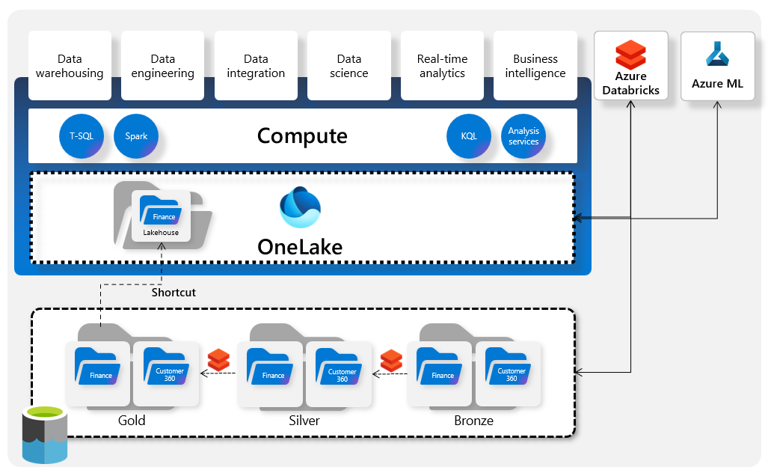
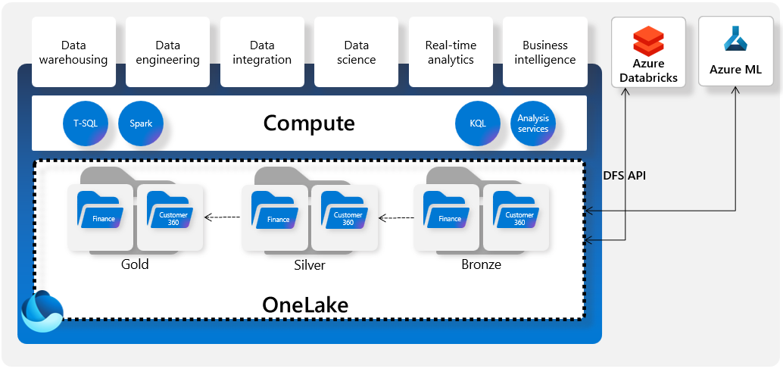
One Lake Scenarios
Use One Lake with existing data lakes
Use and land data directly in OneLkae
Notes:
1- Using OneLake with Existing Data Lakes
OneLake acts as a central storage layer, integrating with external data lakes using shortcuts.
Data is structured into Bronze, Silver, and Gold layers for processing and analysis.
Supports T-SQL, Spark, KQL, and Analysis Services for compute.
Azure Databricks and Azure ML connect for advanced analytics.
2- Using One Lake as Primary Storage
Data is landed and stored directly in OneLake.
Eliminates dependency on external data lakes, simplifying management.
Data is structured into Gold, Silver, and Bronze zones.
Azure Databricks and Azure ML connect via DFS API for processing.

Slide 14
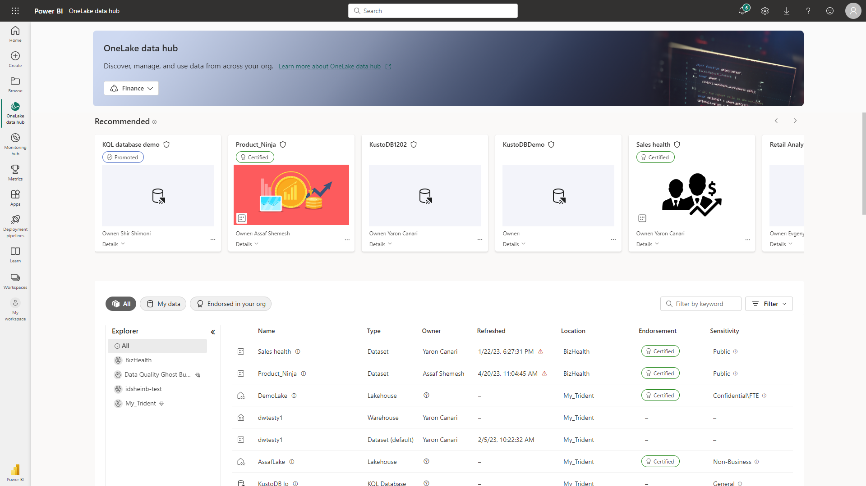
One Lake Data Hub
Discover, manage and use data in one place
Central location within Fabric to discover, manage, and reuse data
Data can be easily discovered by its domain (e.g. Finance) so users can see what matters for them
Efficient data discovery using search, filter and sort
Explorer capability to easily browse and find data by its folder (workspace) hierarchy

Slide 15
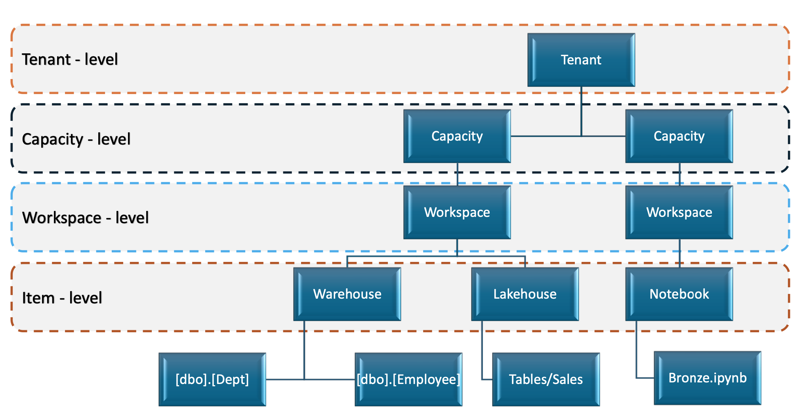
Fabric Terminology
Notes:
key components of Microsoft Fabric using different levels of organization:
Tenant Level
The highest level representing the organization's Fabric environment.
Contains multiple capacities for resource allocation.
Capacity Level
Defines computational resources allocated to different workloads.
Multiple workspaces can run under a single capacity.
Workspace Level
Represents a project or a team within Fabric.
Workspaces contain various items such as Lakehouses, Warehouses, and Notebooks.
Item Level
The lowest level where actual data and workloads reside.
Examples include:
Warehouse → Contains structured data tables like [dbo].[Dept], [dbo].[Employee].
Lakehouse → Stores data in a table format, such as Tables/Sales.

Slide 16

Workspaces & Capacities Accessing One Lake
Workspace A
Capacity A
One Lake
Workspace B
Capacity B
Shortcut
Sales
Lakehouse
Workspace C
Each tenant will have only one One Lake, and any tenant can access files in a One Lake from other tenants via shortcuts

Slide 17
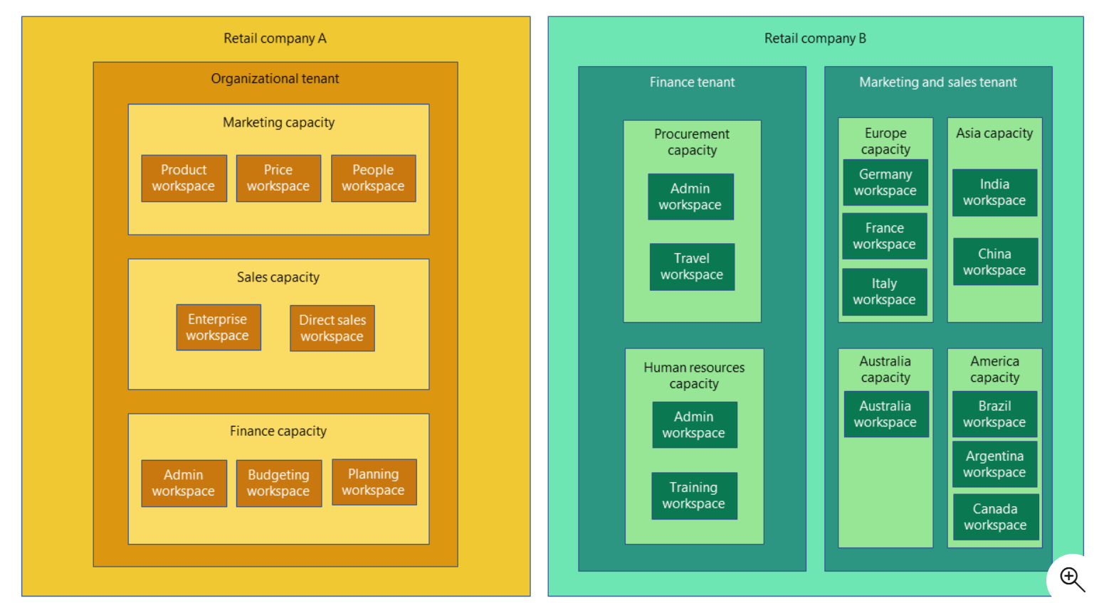
Company Examples
Notes:
Two different Fabric tenant structures for Retail Company A and Retail Company B, showcasing how tenants, capacities, and workspaces are organized.
Retail Company A (Organizational Tenant)
Marketing Capacity
Product Workspace
Price Workspace
People Workspace
Sales Capacity
Enterprise Workspace
Direct Sales Workspace
Finance Capacity
Admin Workspace
Budgeting Workspace
Planning Workspace
Structured by business functions (Marketing, Sales, Finance), each having its own workspaces.
Retail Company B (Finance and Marketing & Sales Tenants)
Finance Tenant
Procurement Capacity:
Admin Workspace
Travel Workspace
Human Resources Capacity:
Admin Workspace
Training Workspace
Marketing and Sales Tenant
Europe Capacity
Germany, France, Italy Workspaces
Asia Capacity
India, China Workspaces
Australia Capacity
Australia Workspace
America Capacity
Brazil, Argentina, Canada Workspaces
Structured by regions (Europe, Asia, America) and functions (Procurement, HR), making it ideal for global companies.
Retail Company A follows a business-function-based structure (Marketing, Sales, Finance).
Retail Company B follows a region-based structure (Europe, Asia, America).
This demonstrates the flexibility of Microsoft Fabric to support different business needs and organizational structures.

Slide 18
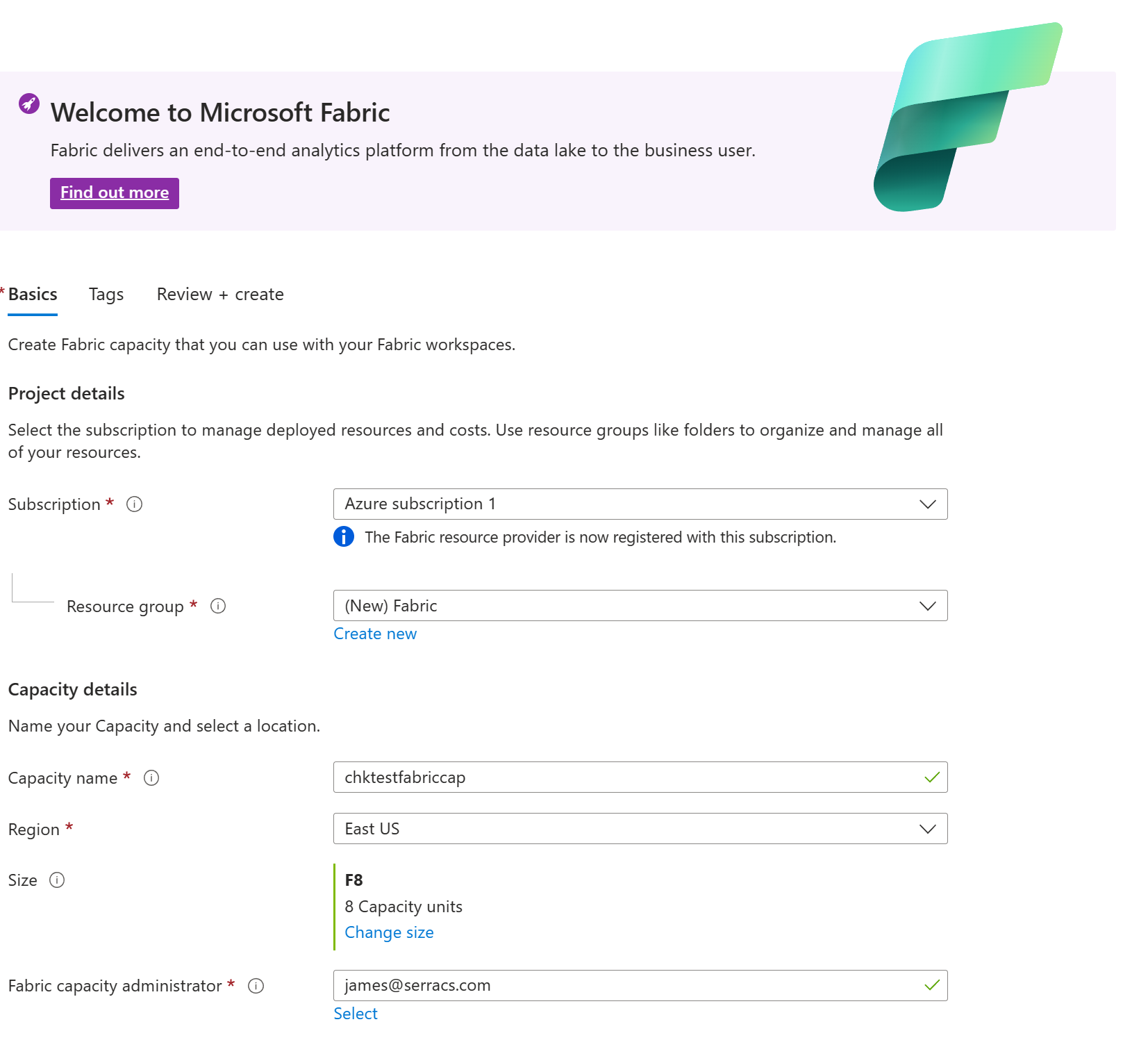
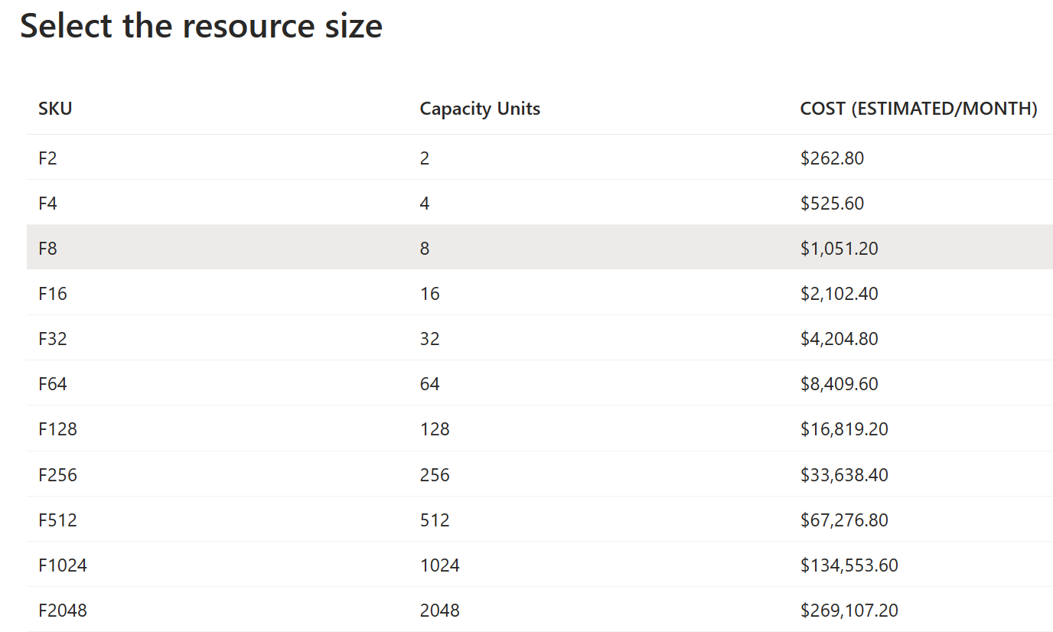
Create Fabric Capacity
Capacity is a dedicated set of resources reserved for exclusive use. It offers dependable, consistent performance for your content. Each capacity offers a selection of SKUs, and each SKU provides different resource tiers for memory and computing power. You pay for the provisioned capacity whether you use it or not.
A capacity is a quota-based system, and scaling up or down a capacity doesn't involve provisioning compute or moving data, so it’s instant.
Notes:
https://learn.microsoft.com/en-us/fabric/enterprise/licenses

Slide 19
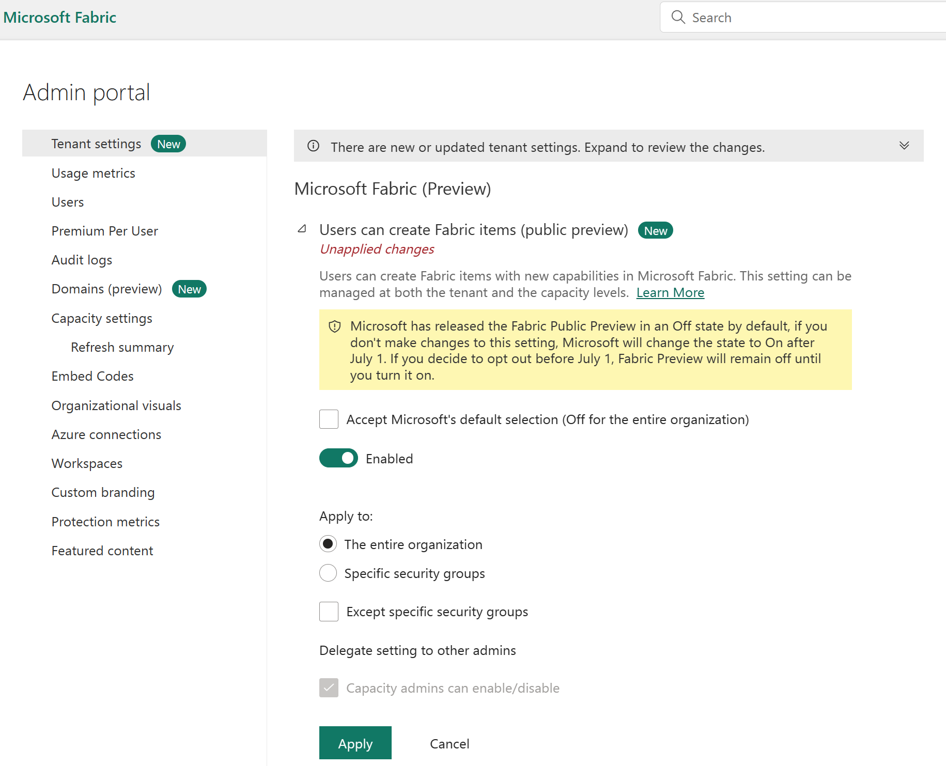
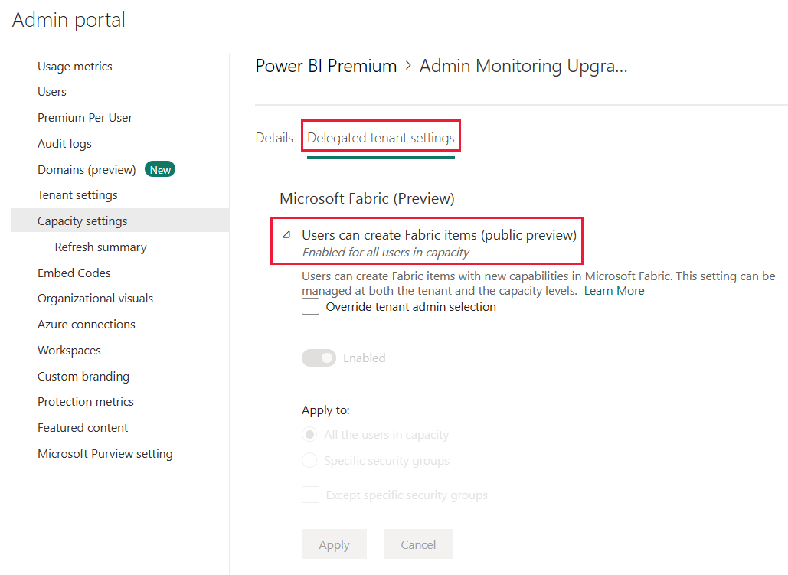
Turning on Microsoft Fabric
Notes:
Public preview available March 23rd. Switch in admin console to run the functionality on/off completely. It will be off by default until July 1st, when it will be switched on unless they go into the admin console and say “No, I don’t want to have this switched on starting July 1st”. Can control at the tenant and capacity levels.
The Microsoft Fabric (Preview) trial includes access to the Fabric product experiences and the resources to create and host Fabric items. The Fabric (Preview) trial lasts until Fabric General Availability (GA), unless canceled. After GA, the Fabric (Preview) trial converts to the GA version and is extended for 60 days.

Slide 20
Building Data Platform
Data Sources
Data Ingestion
Hot Data Store
Data Serving
Data Analytics
Real-time processing - milliseconds
Streaming
(Binary / Avro /.)
Descriptive
What Happen
Near Real-time processing - seconds
Diagnostic
Why is Happen
Unstructured
(Audio /Video /.)
Batch processing - minutes
Predictive
What will happen
Semi Structured
(XML / JSON /.)
Perspective
Make it happen
Cold Data Storage
Structure Data
(Relational DBs)
Actionable Insights
Platform Governance & Operation

Slide 21

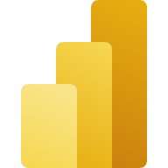


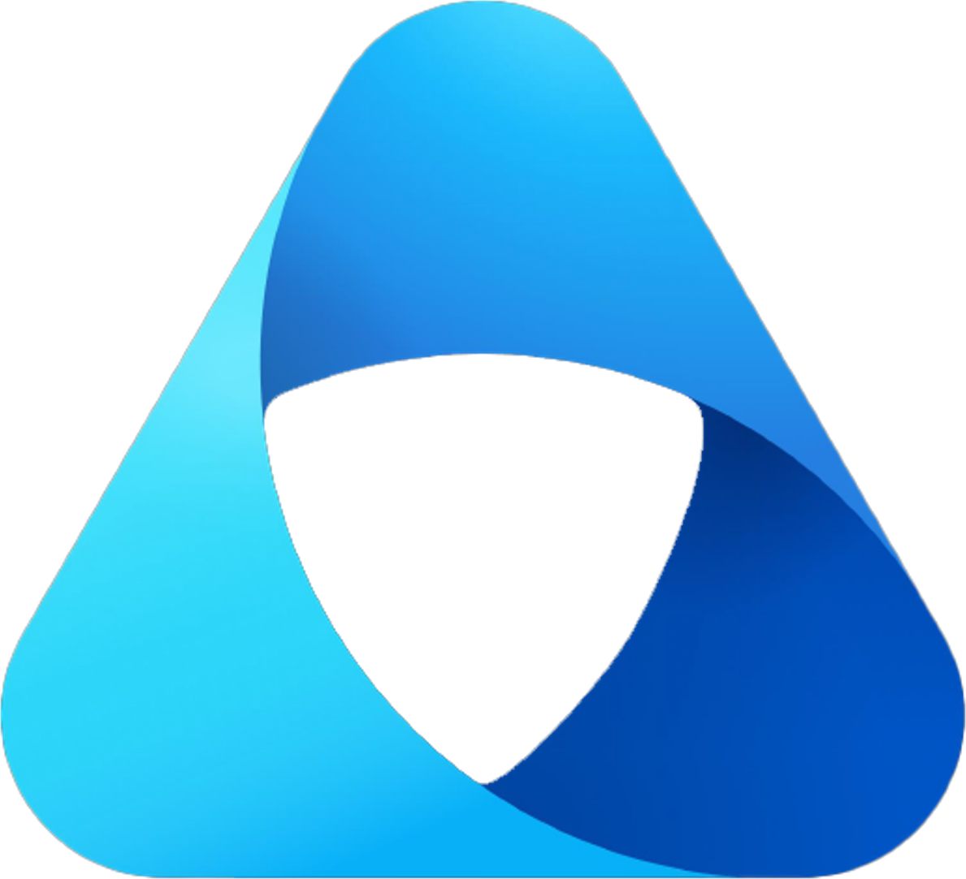
MS Fabric as a Complete Data Platform
Data Sources
Data Ingestion
Hot Data Storage
Data Serving
Data Analytics
Real-time processing - milliseconds
Streaming
(Binary / Avro /.)
Descriptive
What Happen
synapse Real-time Analytics
Near Real-time processing - seconds
Power BI
Diagnostic
Why is Happen
Unstructured
(Audio /Video /.)
One Lake
Batch processing - minutes
Predictive
What will happen
Synapse Data Science
Semi Structured
(XML / JSON /.)
Perspective
Make it happen
Cold Data Storage
Structure Data
(Relational DBs)
Actionable Insights
Data Factory
One Lake
Data Activator
One security
Platform Governance & Operation
Purview

Slide 22
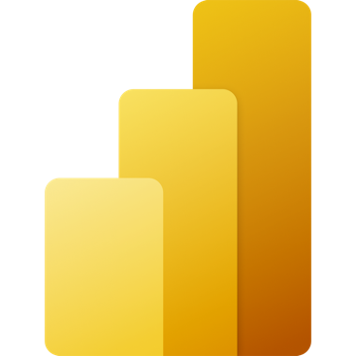
Lakehouse
Data Source
Ingestion
Store
Expose
Shortcut Enabled
Shortcuts
Lakehouse(s)
PBI
Structured / Unstructured
Pipelines & Dataflows
Lake Warehouse
Transform
Notebooks & Dataflows
Notes:
The Microsoft Fabric Lakehouse analytics scenario makes it so that data can be ingested into OneLake with shortcuts to other clouds repositories, pipelines, and dataflows in order to allow end-users to leverage other data.
Once that data has been pulled into Microsoft Fabric, users can leverage notebooks to transform that data in OneLake and then store them in Lakehouses with medallion structure.
From there, users can begin to analyze and visualize that data with Power BI using the see-through mode or SQL endpoints.

Slide 23
Data Warehouse
Data Source
Ingestion
Store
Expose
Shortcut Enabled
Mounts
Data Warehouse
PBI
Structured / Unstructured
Pipelines & Dataflows
Warehouse
Transform
Procedures
Notes:
The Data Warehouse analytics scenario takes existing sources that are mounted, while pipelines and dataflows can bring in all other data that is needed.
IT teams can then define and store procedures to transform the data, which is stored as Parquet/Delta Lake files in One Lake.
From there, business users can analyze and visualize data with Power BI, again using the see-through mode or SQL endpoints.

Slide 24
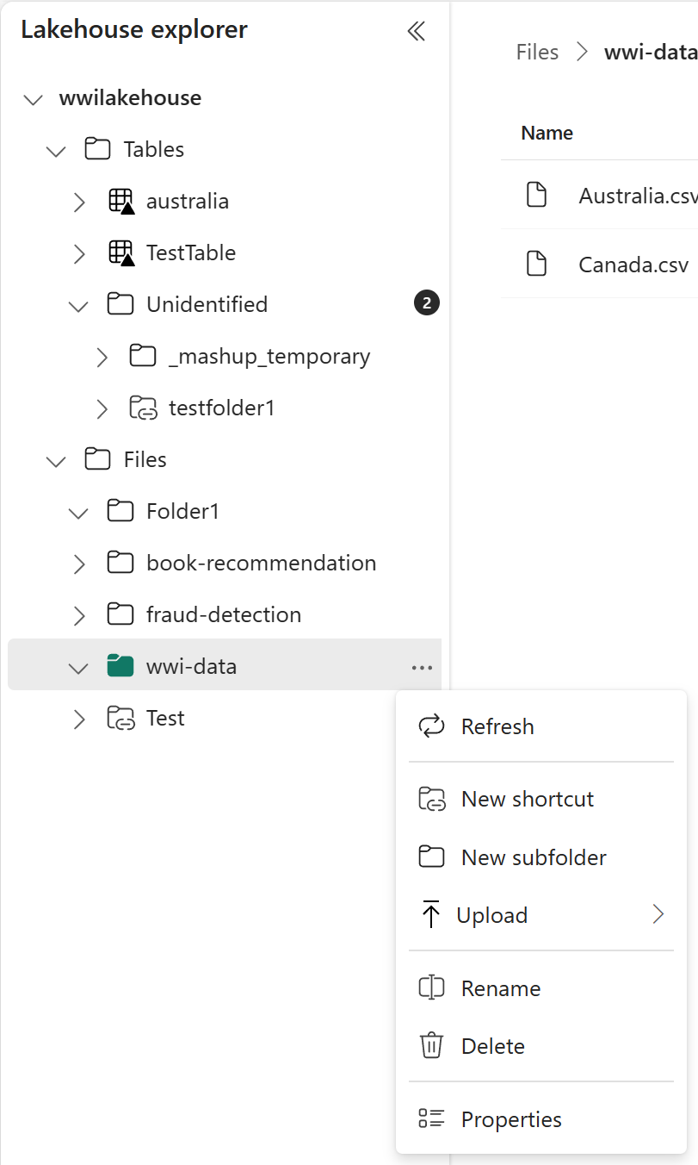
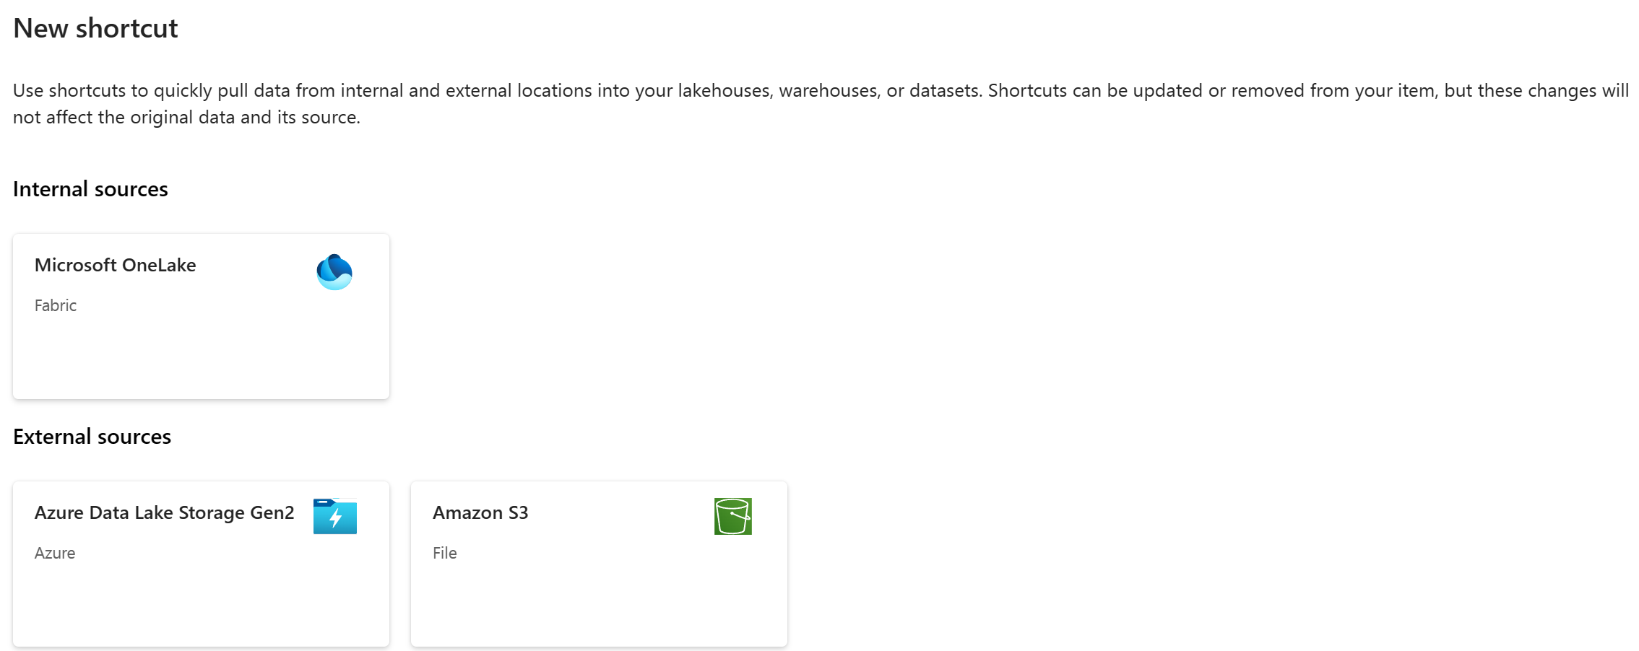


Lakehouse – Shortcuts (to lakehouse)

Slide 25

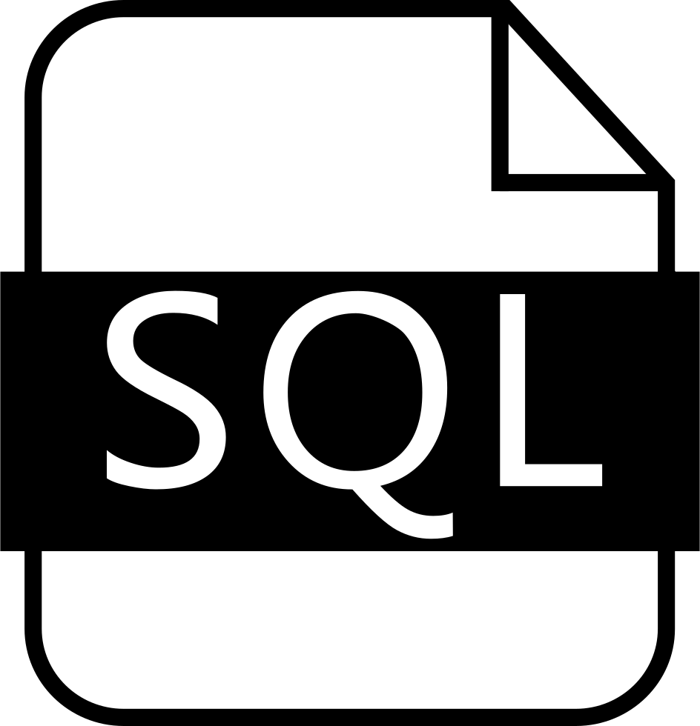


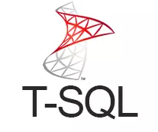

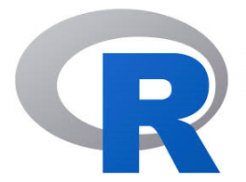


Synapse Data Engineering & Warehousing
Synapse Data Engineering
Synapse Data Warehousing
Use Spark Notebooks
Use SQL Queries & Stored Procedures
Full T-SQL support
Python
R
Scala
Write data into Lakehouse tables
Write data into Warehouse tables

Slide 26
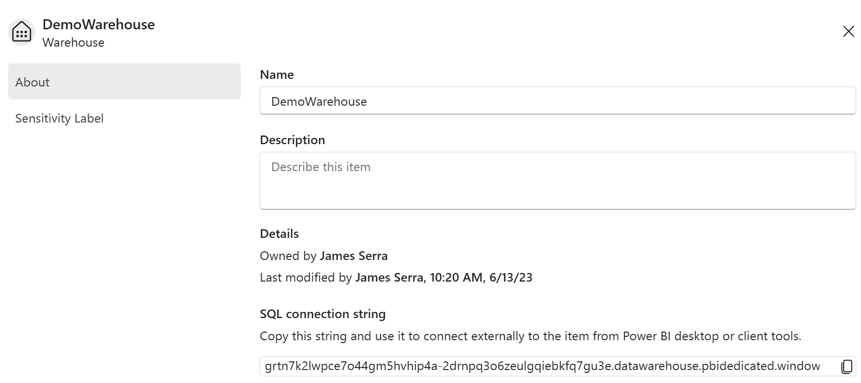
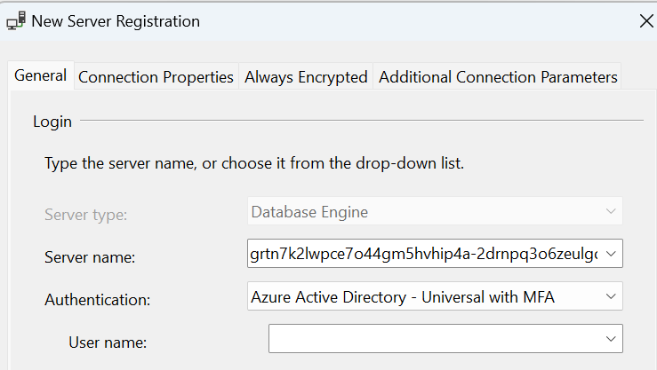
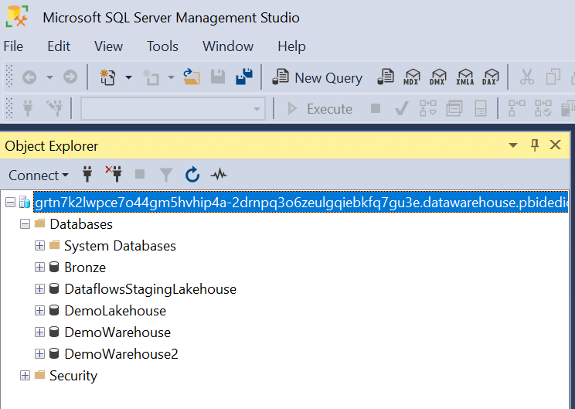
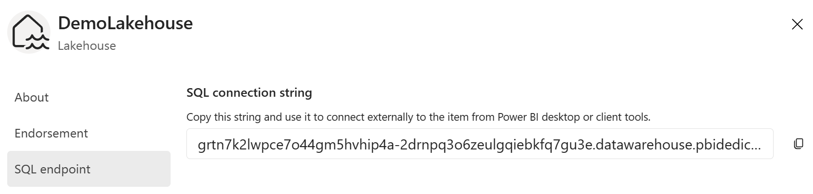
Access via other tools

Slide 27
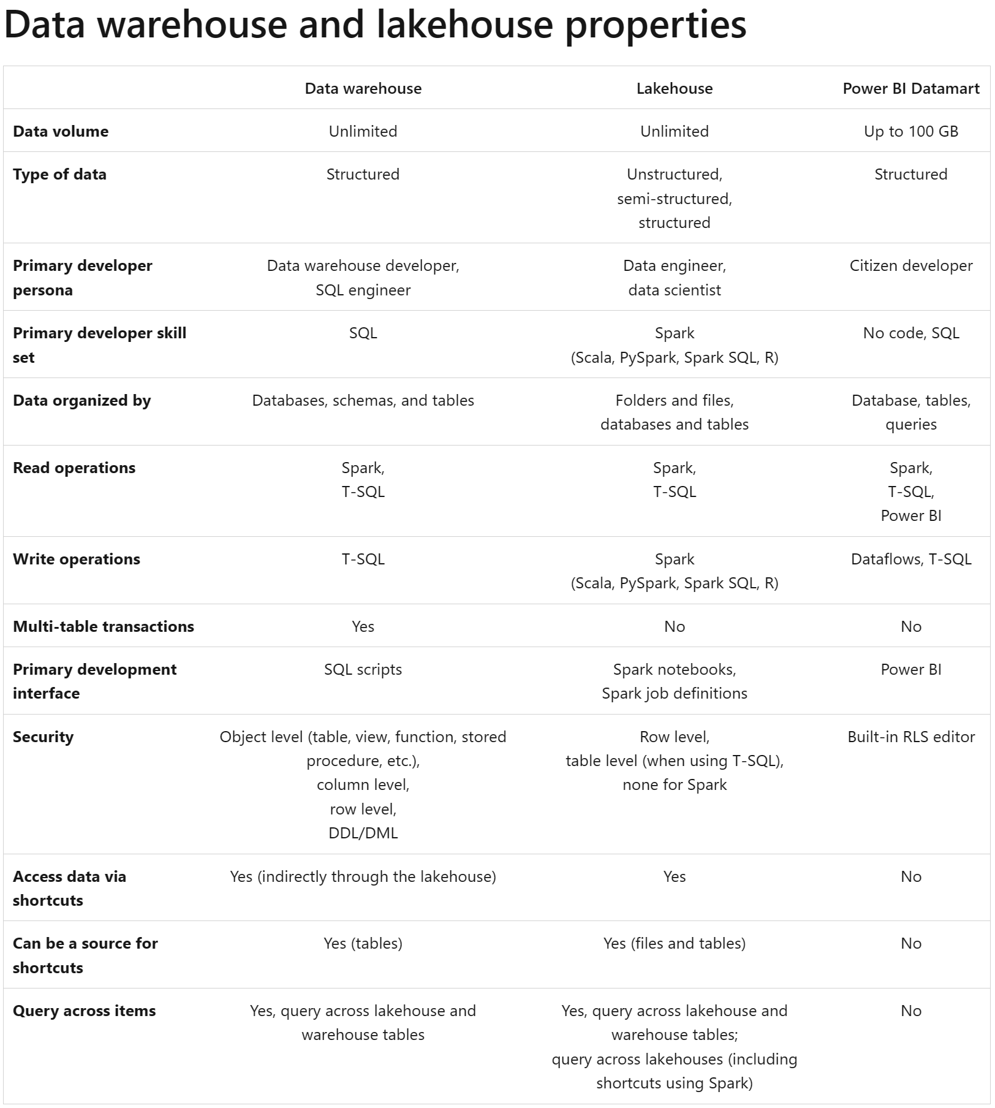
Why two options?
Delta lake shortcomings:
No multi-table transactions
Lack of full T-SQL support (no updates, limited reads)
Performance problem for trickle transactions
Notes:
https://learn.microsoft.com/en-us/fabric/get-started/decision-guide-warehouse-lakehouse
Lakehouse: call it delta lake, owned and managed by Spark, customer can update files - it's user owned. Use if customer likes Spark and using filesWarehouse: well structured, SQL front door, transactional guarantees, multi-table transactions. Nobody except the SQL engine can update the files. Use if customer is comfortable with SQL, comes from a relational database world
LDF and MDF are still used behind the scenes. Can query the warehouse from the lakehouse, but can’t do opposite. Data is synced into onelake from LDF and MDF (only INSERT works for now)
Can't support everything SQL supports with the current open source format at Delta, (multi-table transactions, indexing), so have to use SQL engine
Want to get to a point where don't use LDF/MDF files but use delta underneath. Talk about using Iceberg way down the road
Other knobs to turn? What should we expose? Hide things (DMV, explain plan) because can't tune. Performance DBA's - getting rid of another part of your job

Slide 28


Microsoft Fabric

Slide 29
Microsoft Fabric
Bronze Lakehouse
Silver Lakehouse
Gold Warehouse

Slide 30
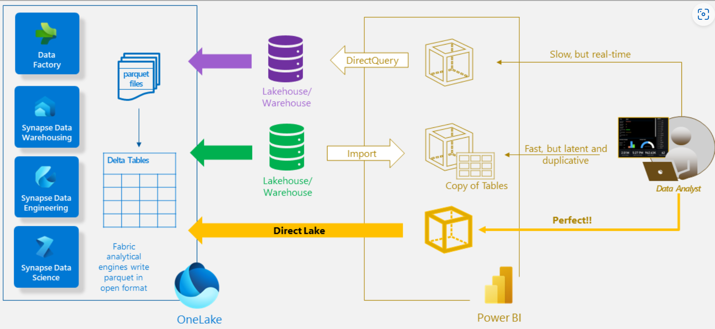
Direct Lake
Notes:
Direct Lake mode is a groundbreaking new engine capability to analyze very large datasets in Power BI.
The technology is based on the idea to load parquet-formatted files directly from a data lake without having to query a Data Warehouse or Lakehouse endpoint and without having to import or duplicate data into a Power BI dataset.
Direct Lake is a fast path to load the data from the lake straight into the Power BI engine, ready for analysis. It loads the data directly from the files into memory at runtime. Because there is no explicit import process, it is possible to pick up any changes at the source as they occur, thus combining the advantages of Direct Query and import mode while avoiding their disadvantages. Direct Lake can read parquet-formatted delta files, but for best performance you should compress the data using the VORDER compression method (50%-70% more compression).
____
It’s an “on-demand” import model – loading into memory the columns in tables which are needed for the query.There is an initial slower cold cache performance.
There is a fall-back mechanism to Direct Query mode in certain scenarios:When the data cannot be loaded into memory.
Query is too complex.
PBI Desktop is used for authoring.
RLS (Row-Level Security) is used.
It can also be seen as a Direct Query mode with some import cache, combining the best of both worlds.
The dataset is tied to the version of the Delta file when the dataset was created.
A refresh is needed to pick up the new version.
At General Availability (GA), this will be configurable – users can choose between showing the latest data or requiring a refresh.

